Slide 1
Evaluating Traffic Management Strategies at an intersection using SUMO
Divyanshu Upadhyay
17064007

Slide 2
INTRODUCTION
Due to fast economic development in India, light-duty vehicle transportation for personal use is experiencing radical growth
This led to traffic congestion which is becoming more and more serious in many cities
In India, until last two decades, the on-road emissions and their ill eﬀects were not taken seriously, thus, no real eﬀort was carried in transportation emission modelling area.
Signalised intersections are considered as pollution hot spots.

Slide 3
INTRODUCTION
The mechanism of the formation and dissipation of traffic jam for signalised or unsignalized intersections at a microscopic or macroscopic level
To propose some strategies for reducing the size of traffic jam and the time for jam dissipation.
Traffic simulation using SUMO, the Simulator of Urban MObility, a software tool.
Using SUMO, a model of intersection is made for applying reinforcement learning techniques to trafﬁc light policies with the aim of increasing trafﬁc ﬂow through intersections.

Slide 4
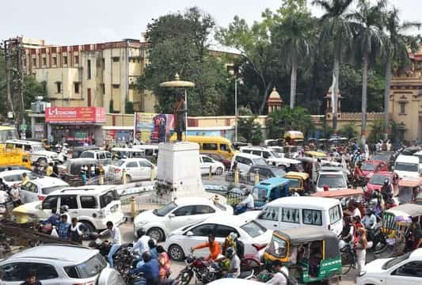
Traffic jam at BHU Main Gate Intersection

Slide 5
Overview of Transportation Simulation Software
Aimsun Live (Commercial),
TSIS-CORSIM, CORridor SIMulation (Commercial)
Paramics, PARAllel MICroscopic Simulation (Commercial),
PTV Vissim, (Commercial),
SimMobility, (by Singapore-MIT)
Synchro + SimTraffic, (Commercial)
MATSim, Multi-Agent Transport Simulation , (Open Source)
Transims, TRansportation ANalysis SIMulation System (NASA Open Source)
SUMO Simulation of Urban Mobility, (DLR, Open Source)

Slide 6
SUMO [Simulation of Urban MObility]
A software tool being developed by the DLR - Institute of Transportation Systems of DLR, the National Aeronautics and Space Research Center of the Federal Republic of Germany in Berlin
SUMO is an open source (licensed under the GPL), highly portable, microscopic and continuous road trafﬁc simulation package designed to handle large road networks
The simulation platform offers many features, like microscopic simulation, online interaction and the simulation of multimodal trafﬁc.
Time schedules of trafﬁc lights can be imported or generated automatically by SUMO and there are no artiﬁcial limitations in the network size and the number of simulated vehicles.
SUMO uses its own ﬁle formats for trafﬁc networks, but it is able to import maps encoded in many public available formats like OpenStreetMap, VISUM, VISSIM and NavTeq.

Slide 7
Three Ways of Creating Road Networks
Manually by creating our own node, edge, route, connection files
Using net generate command
Importing road network from external sources such as OSM, VISSIM, VISUM etc.

Slide 8
Manual method :
A road network consists of:
nodes (junctions)
edges (i.e. roads that connect various junctions with each other)
Type of edge ( i.e no. of lanes etc)
Route

Slide 9
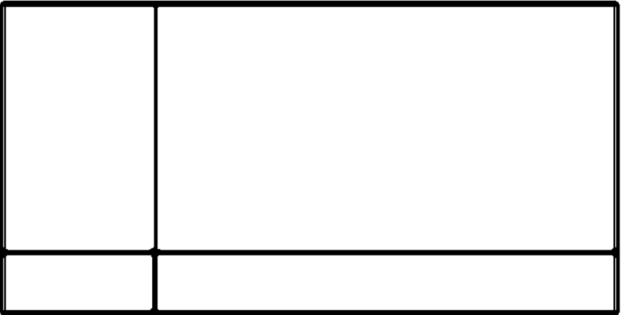
Example of Manual method :
n7
n8
n9
n6
n5
n4
n1
n2
n3

Slide 10
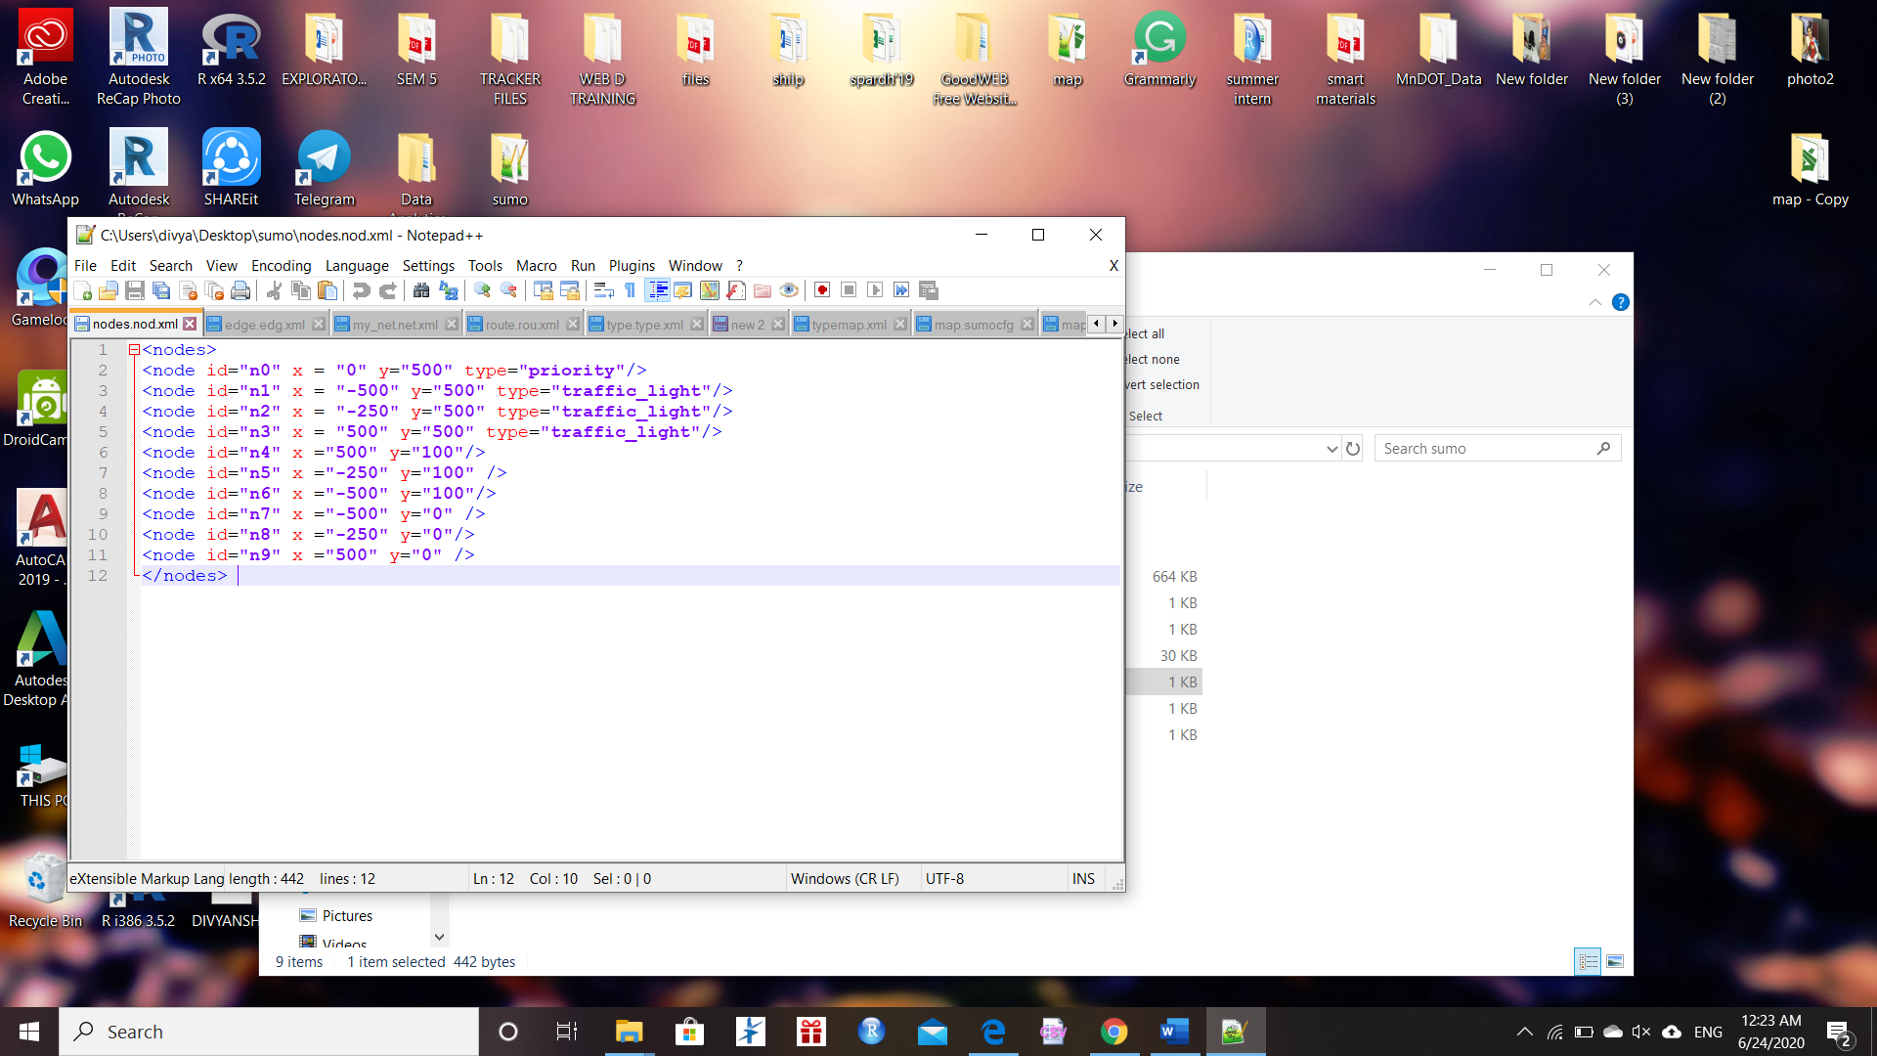
Node file :

Slide 11
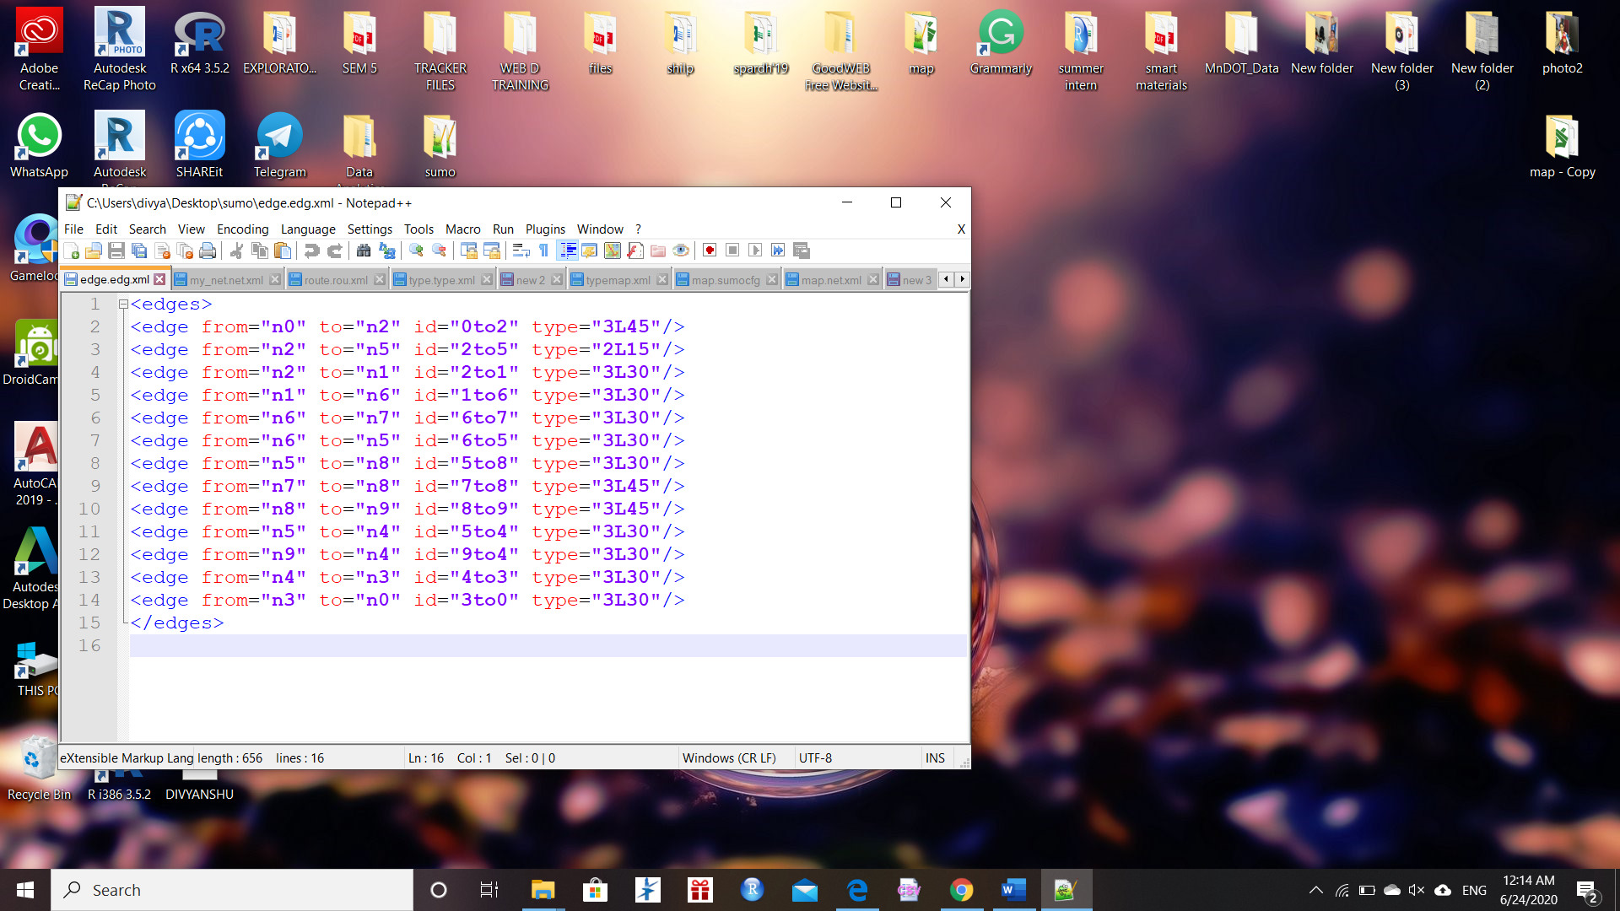
Edge File :

Slide 12
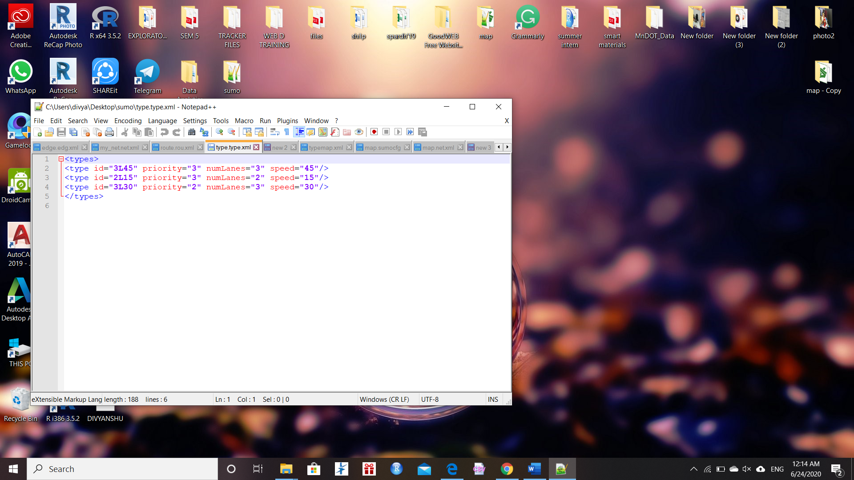
Type file :

Slide 13
Manual method :
+
+
=
Nodes.nod.xml
edge.edg.xml
Type.type.xml
My_net.net.xml

Slide 14
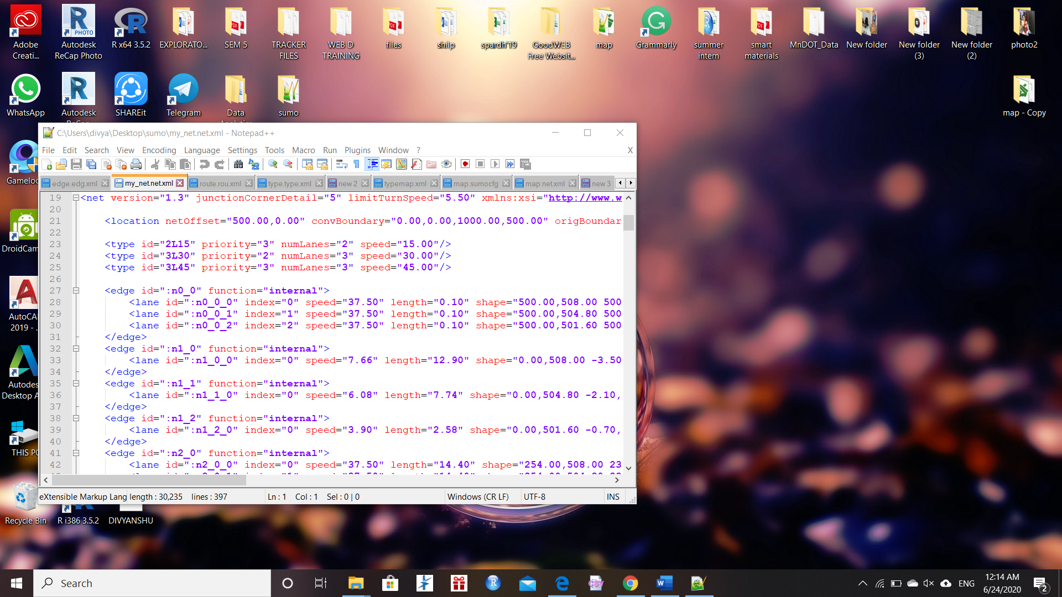
Net file :

Slide 15
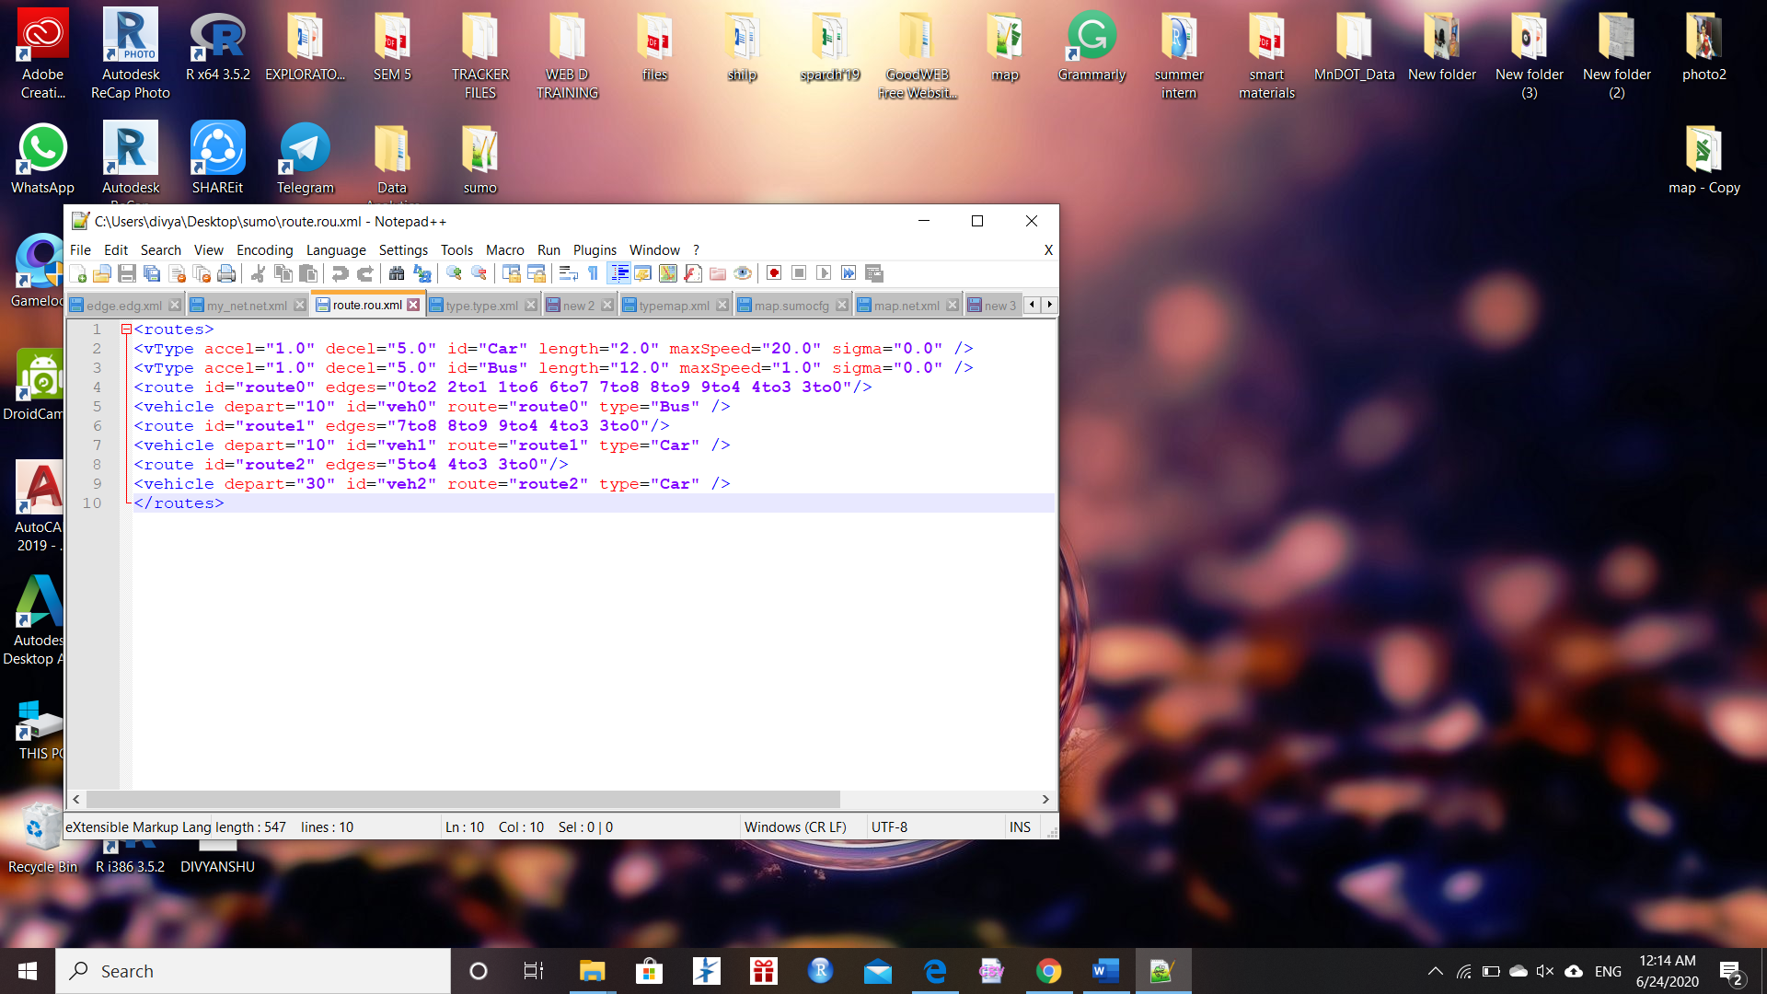
Route File :

Slide 16
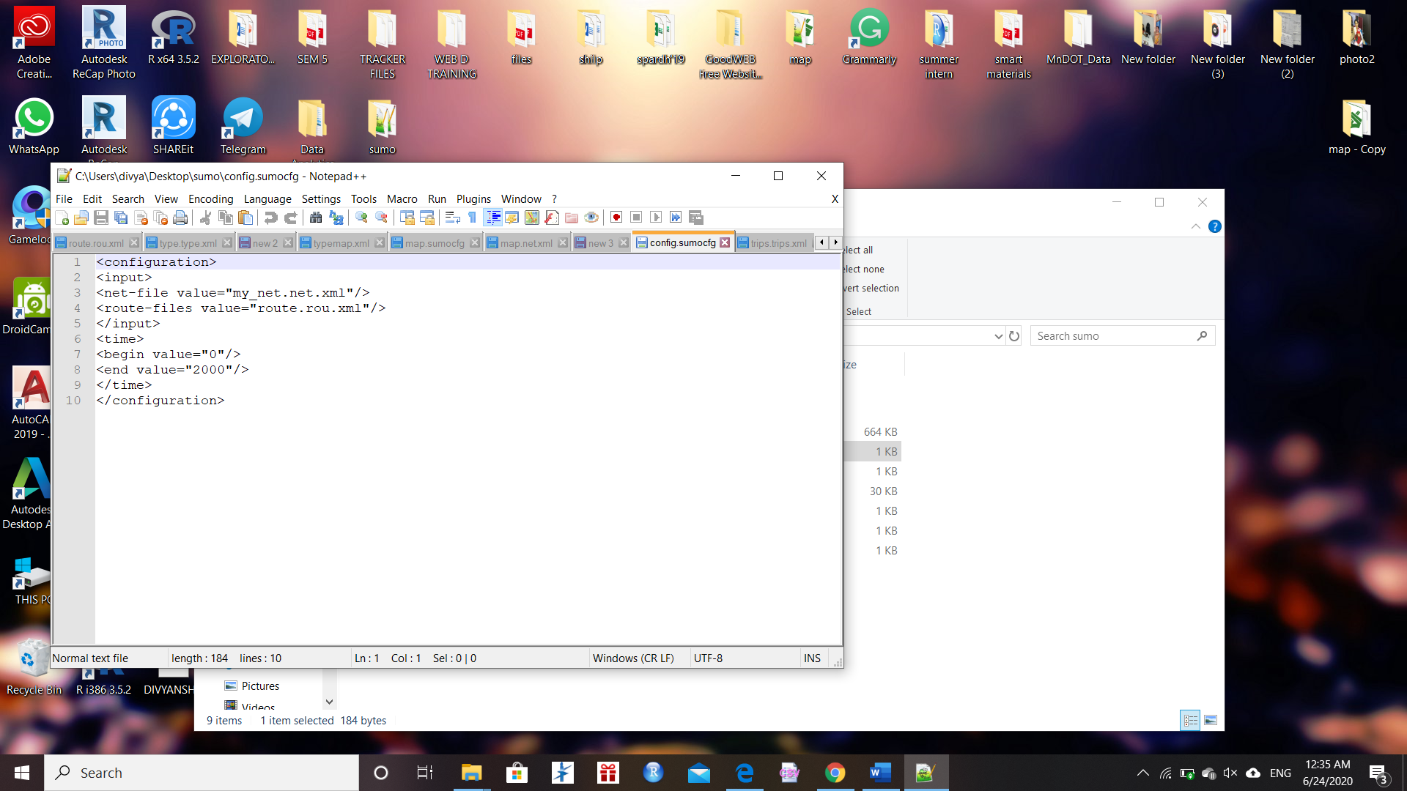
Configuration file :

Slide 17
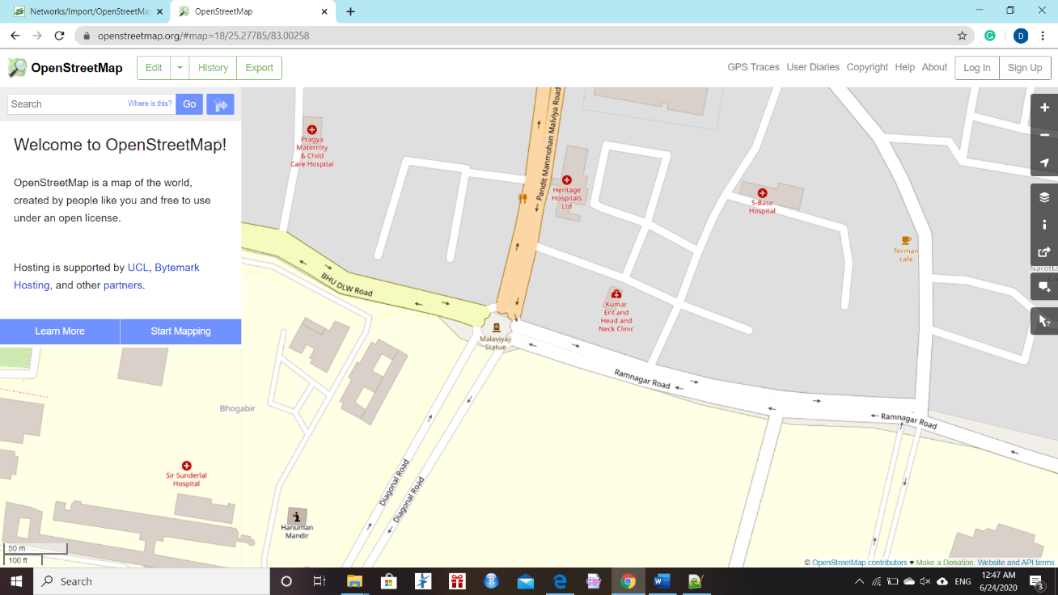
Acquiring a map from OpenStreetMap
Use a Web browser and access the web page at:
www.openstreetmap.org

Slide 18
Convert the Map into SUMO Network
Use the NETCONVERT tool to convert the OSM ﬁle to the .net.xml ﬁle format, in order to use it for the SUMO simulation.
Different simulation scenarios require different modes of traffic and thus different parts of the traffic infrastructure to be imported
netconvert --osm .osm -o .net.xml
--geometry.remove --roundabouts.guess --ramps.guess --junctions.join --tls.guess-signals --tls.discard-simple --tls.join

Slide 19
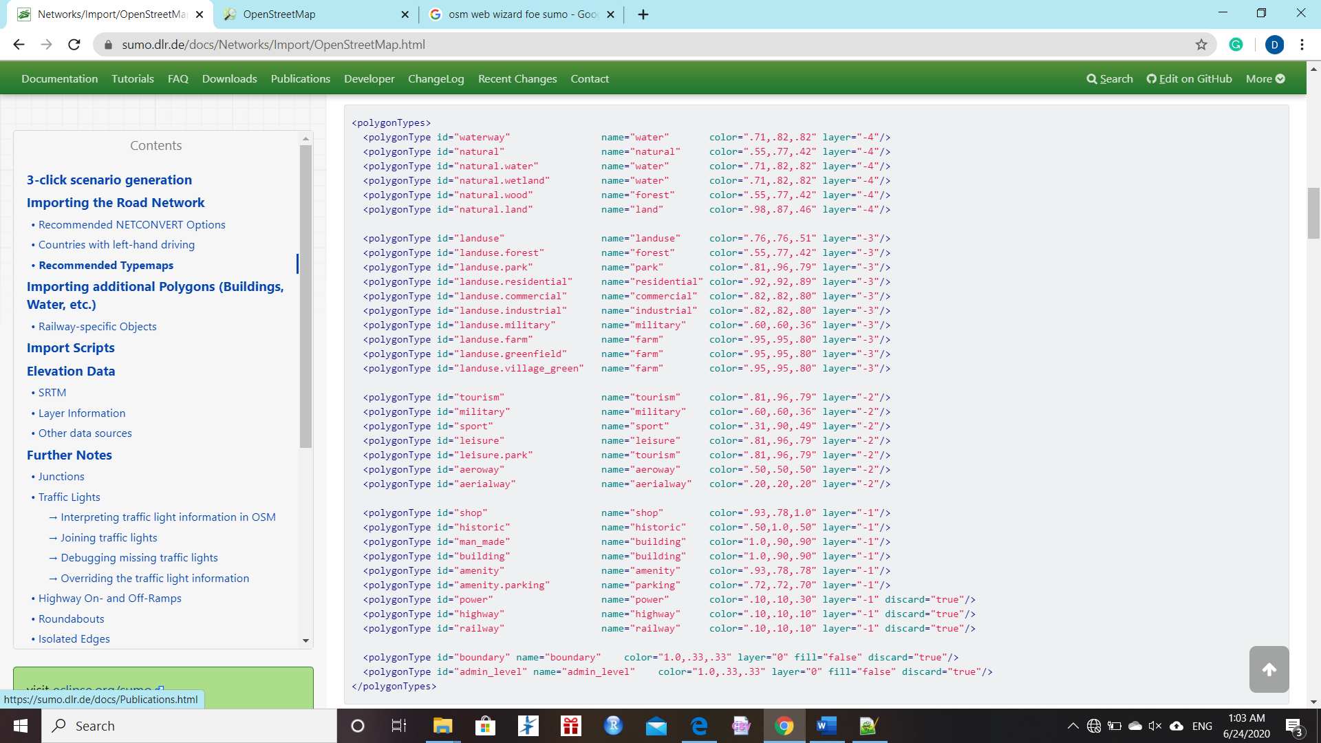
Use the POLYCONVERT tool to import polygons from OSM-data and produce a Sumo-polygon ﬁle.

Slide 20
Use the POLYCONVERT tool to import polygons from OSM-data and produce a Sumo-polygon ﬁle
The generated polygon ﬁle can now be used in a conﬁguration ﬁle for sumo-gui
polyconvert --net-file <name>.net.xml --osm-files <name>.osm --type-file typemap.xml -o <name>.poly.xml
<configuration>
<input>
<net-file value="example.net.xml"/>
<additional-files value="example.poly.xml"/>
</input>
</configuration>

Slide 21
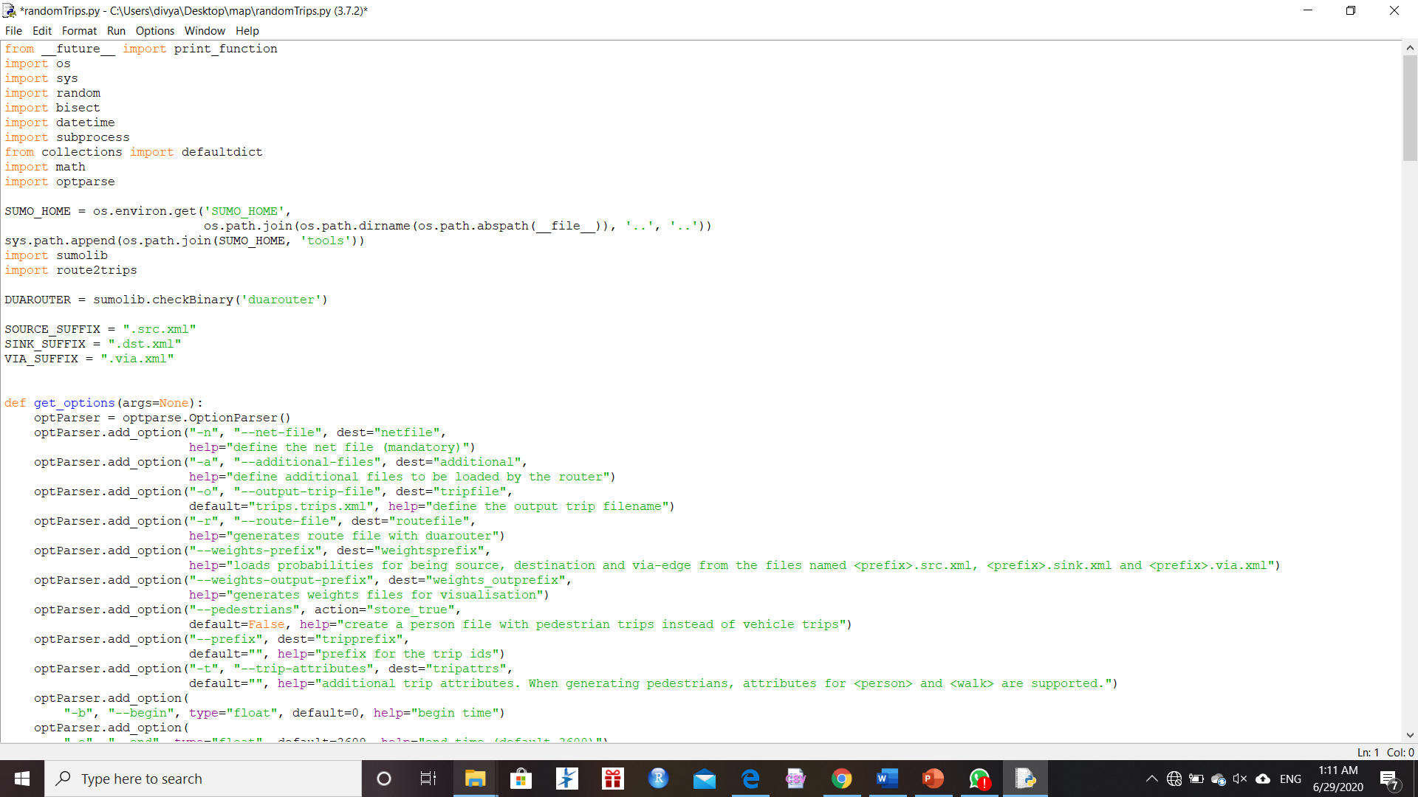
Add trip and route to the network using build-in Python scripts randomTrips.py
randomTrips.py -n name.net.xml -e 5000 -r name.rou.xml

Slide 22
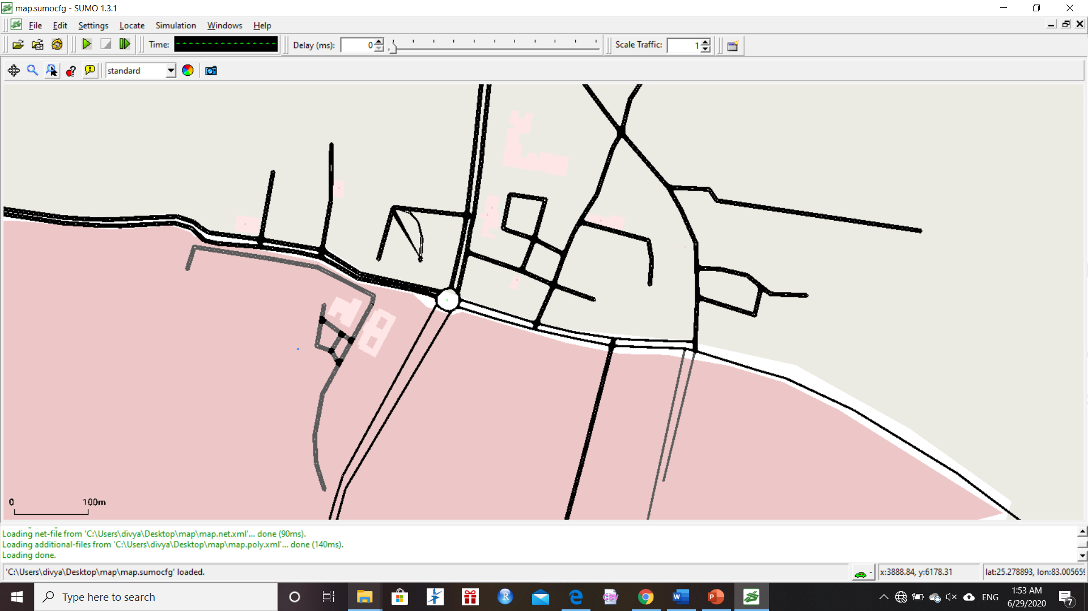
Map from OpenStreetMap

Slide 23
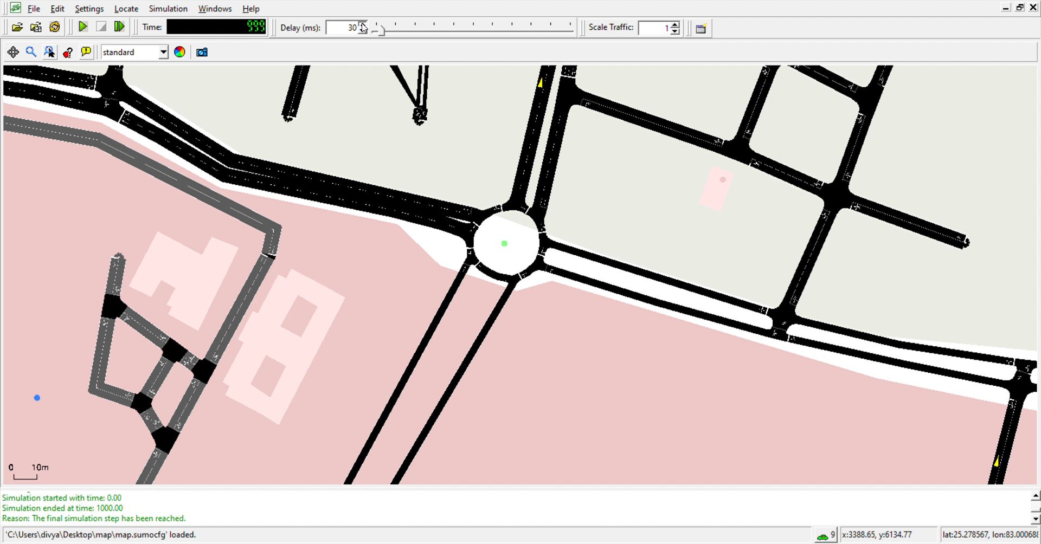

Slide 24
APPROACH :
We have chosen an intersection (say BHU Main Gate) and generated a model by extracting data from OSM
Then use poly SUMO file to get a model of that intersection
We have attached a RandomTrip.py file to see the flow of random traffic over the intersection
Now our aim is to compare the various traffic signal algorithm for this random trips to decide which case have minimised traffic

Slide 25
Algorithms used :
Four algorithms are implemented and compared against each other are :
Short Cycle
Long Cycle
Q-learning approach
Longest Queue First (LQF)

Slide 26
Short Cycle :
Short Cycle changes the phase every 15 seconds in a round-robin fashion
Long Cycle :
Long Cycle changes the phase every 45 seconds in a round-robin fashion

Slide 27
Longest Queue First (LQF)
LQF chooses to let the direction with the highest number of cars be green.
In the real world, it is not possible to directly ﬁnd queue lengths, and we extracted this information directly from the simulator.
Although LQF is a greedy algorithm, it is given more information than Q-learning, which makes it a reasonable target for comparison.

Slide 28
Q-learning
The ‘Q’ in Q-learning stands for quality ( Quality in this case represents how useful a given action is in gaining some future reward )
Algorithm that seeks to find the best action to take given the current state
Q-learning function learns from actions that are outside the current policy, like taking random actions, and therefore a policy isn’t needed
Q-learning seeks to learn a policy that maximizes the total reward.

Slide 29
Here are the 3 basic steps:
Agent starts in a state (s1) takes an action (a1) and receives a reward (r1)
Agent selects action by referencing Q-table with highest value (max) OR by random (epsilon, ε)
Update Q-values
Q[state, action] = Q[state, action] + lr * (reward + gamma * np.max(Q[new_state, :]) — Q[state, action])

Slide 30
Command prompt
python training_main.py
results will be stored in "./model/model_x/" where x is an increasing integer starting from 1
python testing_main.py
Get the csv file as output for step time, reward point, total stopped
Calculate the average number of vehicle in queue and plot graph

Slide 31
Output graph for q-learning approach

Slide 32
Average number of cars waiting at stoplights during the simulation

Slide 33
Result :
Q-Learning Reinforcement Learning agent tries to choose the correct traffic light phase at an intersection to maximize traffic efficiency
Form the data we can conclude that using q-learning algorithm is more efficient then the other algorithms we have used
We observed that using q-learning approach reduces the congestion and the size of traffic jam and the time for jam dissipation

Slide 34
Future work :
We will feed the BHU Main Gate intersection data in the modal
Then we will run all the algorithms as we have done for random trip data
Then we will compare the graphs and data
And try to conclude the best possible algorithm
Also we will try to plot the CO2 data using SUMO and try to minimize the emission in similar manner

